Slide 1
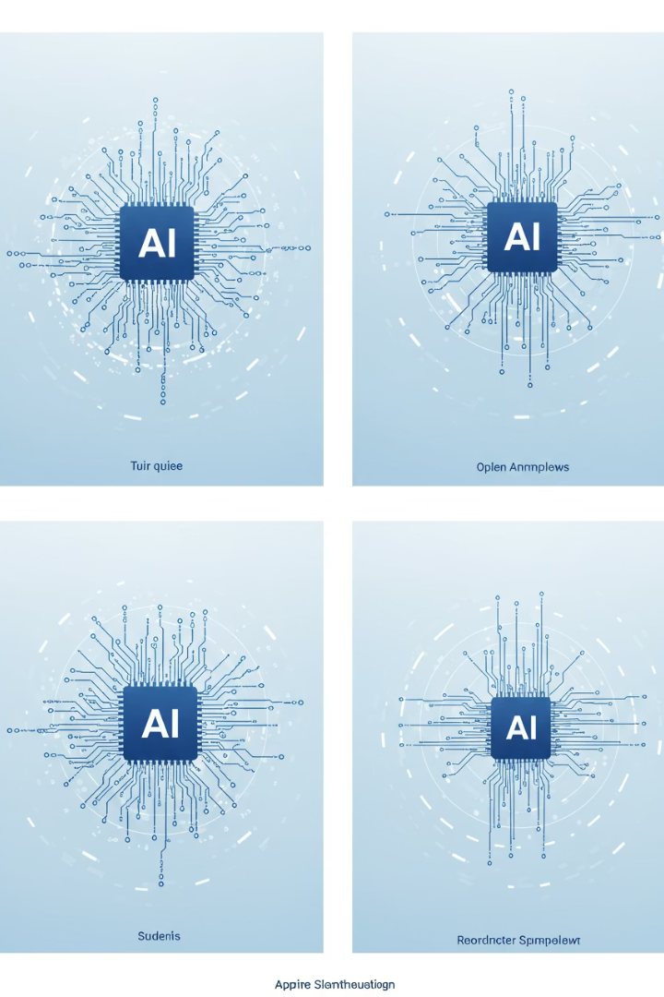




Understanding Our AI Options
Zero-Shot Learning with Structured Prompting
AI generates scenarios based on general understanding, guided by structured prompts and formatting rules.
Retrieval-Augmented Generation (RAG)
AI searches a knowledge base for relevant information before generating informed test scenarios.
Prompt Fine-Tuned with Few-Shot Examples
AI learns from 5-10 high-quality examples to generate new, similar scenarios.
LLM Fine-Tuning
Intensive process training the core AI model with thousands of company-specific test cases.

Slide 2
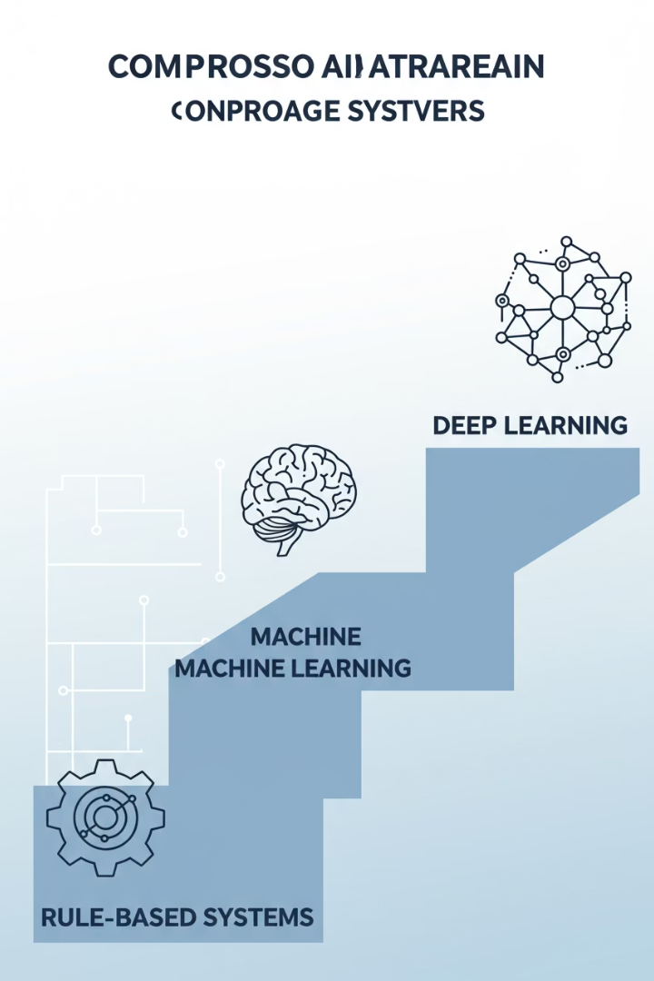
Comparing the Approaches
Feature
Zero-Shot
RAG
Few-Shot
LLM Fine-Tuning
Data Needed
Structured Prompts
Knowledge Base
Small set of examples
Large dataset
Effort
Low
Medium
Medium
High
Customization
Low-Medium
Medium
Medium-High
Very High
Our Focus
Baseline
Potential
MVP
Post-MVP

Slide 3





Our Strategic Phased Approach
MVP: Few-Shot Examples
Quickly achieve higher-quality test scenarios with a small set of our best examples.
Demonstrate Value
Learn and iterate with manageable investment while showing immediate benefits.
Gather More Data
Collect and organize company-specific test cases for deeper AI training.
Post-MVP: LLM Fine-Tuning
Build a deeply specialized "in-house expert" for maximum accuracy and efficiency.

Slide 4
Why "Few-Shot Examples" for Our MVP?
Advantages vs. Zero-Shot Learning
Advantages vs. RAG
Superior output quality and specificity
Lower initial infrastructure overhead
More intuitive and direct guidance
Simpler implementation and faster time-to-value
Reduced ambiguity and quicker learning
More controlled and potentially lower prompt costs

Slide 5

Understanding Fine-Tuning
What Are "Weights"?
What Happens in Fine-Tuning?
Think of an AI model as a complex brain with millions of tiny adjustment points or "knobs" called weights.
Fine-tuning tweaks those "knobs" using our company's specific data.
The model learns our way of doing things, using our terminology and following our style.
Each weight controls how the model "thinks"—understanding words, connecting ideas, forming responses.
The Specialist Chef Analogy
Original AI: A talented chef who knows how to cook almost everything.
Fine-Tuned AI: That chef after learning your grandmother's secret recipes.

Slide 6

The Strategic Advantage of LLM Fine-Tuning
↓40%
Token Costs
Shorter prompts mean lower cost per request
↑60%
Productivity
More accurate outputs mean less editing time
↑90%
Accuracy
Domain-specific outputs mean fewer errors
↓30%
Complexity
Can reduce need for separate RAG systems

Slide 7








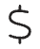
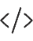
Choosing Our AI Engine: Why Google's Gemini?
Long Context Recall
Context Window
~99% at 1M tokens, ensuring details aren't missed
Up to 1M-2M tokens vs competitors' 128K-1M
Reasoning
~90% MMLU, ~84-90% GPQA for logical, comprehensive tests
Cost Efficiency
~$1.25-$2.50 per 1M tokens vs competitors' ~$2.00
Coding
~63.8% on SWE-Bench vs competitors' ~54.6%

Slide 8



Understanding AI Costs: Tokens and Expenses
What is a Token?
"Word pieces" or text chunks (100 tokens ≈ 75 English words)
How Pricing Works
Cost based on total tokens processed (input + output)
Scaling Costs
Individual operations are cheap (~$0.022) but scale with volume

Slide 9
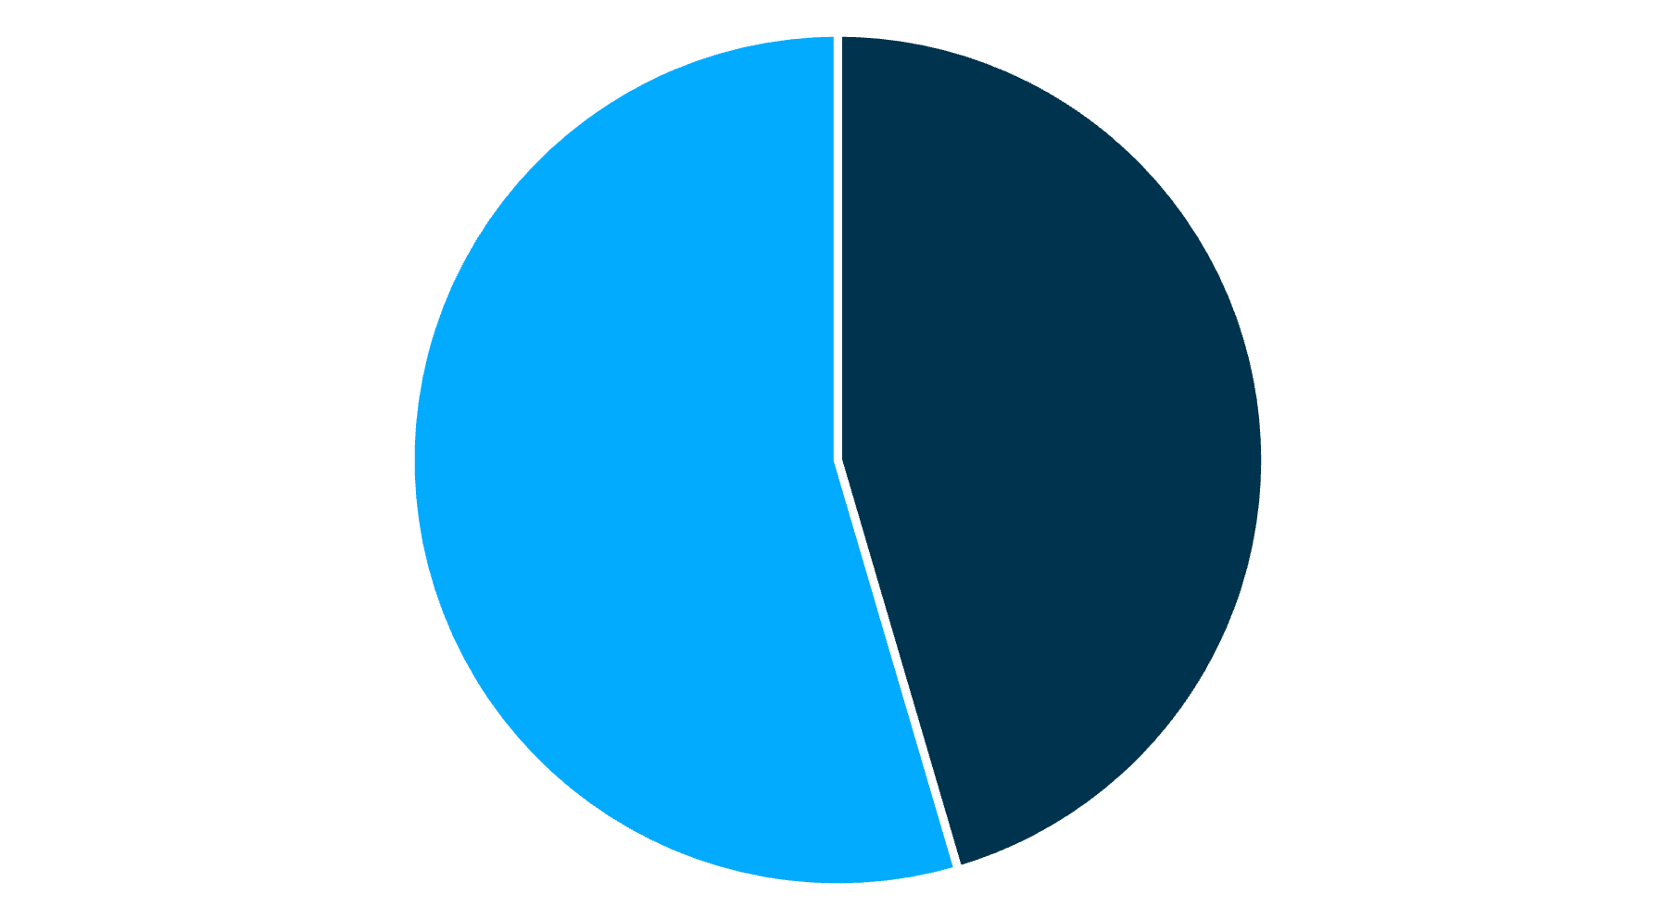
Cost Example Breakdown
Input Tokens
Output Tokens
For a single operation processing a 5-page PDF:
Input: 5,000 tokens at $2.00/million = $0.01
Output: 1,500 tokens at $8.00/million = $0.012
Total per operation: $0.022
Scaling to 10,000 operations: approximately $220

Slide 10








Cost Management Strategy
Continuous Monitoring
Track usage and optimize regularly
Fine-Tuning (Post-MVP)
Reduce prompt length and improve efficiency
Right Model Selection
Match capabilities to specific tasks
Efficient Prompts
Craft concise, effective instructions

Slide 11

Next Steps in Our AI Journey
Select and Curate Few-Shot Examples
Identify 5-10 high-quality test scenarios that represent our ideal output format and style.
Implement MVP with Gemini
Deploy the Few-Shot approach using Google's Gemini AI to generate initial test scenarios.
Measure Results and Gather Feedback
Evaluate quality, efficiency gains, and collect user feedback to refine our approach.
Begin Data Collection for Fine-Tuning
Start organizing company-specific test cases to prepare for future LLM fine-tuning.

